Slide 1

Module Two: Program Structure
What to cover
Components of C ++ Program
Statements and Expression
Functions
Libraries and the C++ Standard Library
Structure of simple C++ program
Running a C++ Program
Run a program
Testing and Debugging

Slide 2
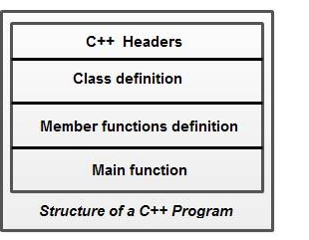
Basic Elements of C++ Program
Programs are a sequence of instructions or statements. These statements form the structure of a C++ program. C++ program structure is divided into various sections, namely,
Header File Section
Class Declaration section
Member Function definition section
Main function section

Slide 3
Note that C++ provides the flexibility of writing a program with or without a class and its member functions definitions.
A simple C++ program (without a class) includes comments, headers, namespace, main() and input/output statements.
Comments are a vital element of a program that is used to increase the readability of a program and to describe its functioning. Comments are not executable statements and hence, do not increase the size of a file.
\\Asimple C++ program ----->This is comment and is ignored by Compiler
#include <iostream> ------> Header
Using namespace std; -----> This tells the compiler to use std namespace
int main() -----> Main Function
{
cout<<“First C++ program”; ---->This is the body of Main {} It contains code
return 0;
}

Slide 4
Comments
C++ supports two comment styles: single line comment and multiline comment.
Single line comments are used to define line-by-line descriptions. Double slash (//) is used to represent single line comments.
For example, consider this statement // An example to demonstrate single line comment
Multiline comments are used to define multiple lines descriptions and are represented as /* */. For example, consider this statement.
/* An example to demonstrate multiline comment */

Slide 5
Headers:
.
Header files contain definitions of Functions and Variables, which is imported or used into any C++ program by using the pre-processor #include statement.
#include is a specific preprocessor command that effectively copies and pastes the entire text of the file, specified between the angle brackets, into the source code

Slide 6
Header File
Generally, a program includes various programming elements like built-in functions, classes, keywords, constants, operators, etc., that are already defined in the standard C++ library. In order to use such pre-defined elements in a program, an appropriate header must be included in the program.
The standard headers contain the information like prototype, definition and return type of library functions, data type of constants, etc. As a result, programmers do not need to explicitly declare (or define) the predefined programming elements.
Standard headers are specified in a program through the preprocessor directive" #include.

Slide 7
In Figure, the iostream header is used. When the compiler processes the instruction #include<iostream>,
The file <iostream>, which is a standard file that should come with the C++ compiler, is short for input-output streams. This command contains code for displaying and getting an input from the user.
This enables the programmer to use standard input, output and error facilities that are provided only through the standard streams defined in <iostream>.
These standard streams process data as a stream of characters, that is, data is read and displayed in a continuous flow. The standard streams defined in <iostream> are listed here. cin,cout,cerr & clog

Slide 8
• cin (pronounced "see in") : It is the standard input stream that is associated with the standard input device (keyboard) and is used to take the input from users.
• cout (pronounced "see out") : It is the standard output stream that is associated with the standard output device (monitor) and is used to display the output to users.
• cerr (pronounced "see err") : It is the standard error stream that is associated with the standard error device (monitor) and is used to report errors to the users. The cerr object does not have a buffer (temporary storage area) and hence, immediately reports errors to users. '
• clog (pronounced "see log"): It is the buffered error stream that is associated with the standard error device (computer screen) and is used to report errors to users. Unlike cerr, clog reports errors to users only when the buffer is full

Slide 9
For many years, C++ applied C-style headers, that is, .h extension in the headers. However, the standard C++ library introduced new-style headers that include only header name. Hence, the most modem compilers do not require any extension, though they support the older .h extension. Some of C-style headers and their equivalent C++ style headers are listed in Table.

Slide 10
Namespace: Since its creation, C++ has gone through many changes by the C++ Standards Committee. One of the new features added to this language is namespace. A namespace permits grouping of various entities like classes, objects, functions and various C++ tokens, etc., under a single name. Different users can create separate namespaces and thus can use similar names of the entities. This avoids compile-time error that may exist due to identical-name conflicts.
The C++ Standards Committee has rearranged the entities of the standard library under a namespace called std. In Figure, the statement using namespace std informs the compiler to include all the entities present in the namespace std. The entities of a namespace can be accessed in different ways which are listed here.

Slide 11
By specifying the using directive
using namespace std;
cout<<"Hello World";
• By specifying the full member name
std: :cout<<"Hello World";
• By specifying the using declaration
using std :: cout;
cout<<"Hello World";
As soon as the new-style header is included, its contents are included in the std namespace. Thus, all the modern C++ compilers support these statements.
#include<iostream>
using namespace std;

Slide 12
Main Function:
The starting point of all C++ programs is the main function
The main () is a startup function that starts the execution of a c++ program.
This function is called by the operating system when your program is executed by the computer.
All C++ statements that need to be executed are written within main ( ).
The compiler executes all the instructions written within the opening and closing curly braces' {}' that enclose the body of main ( ).
{ signifies the start of a block of code, ​and } signifies the end.

Slide 13
Once all the instructions in main () are executed, the control passes out of main ( ), terminating the entire program and returning a value to the operating system.
By default, main () in C++ returns an int value to the operating system. Therefore, main () should end with the return 0 statement. A return value zero indicates success and a non-zero value indicates failure or error.

Slide 14
Statements and expressions
The most common type of instruction in a program is the statement.
A statement in C++ is the smallest independent unit in the language. In human language, it is analogous to a sentence.
We write sentences in order to convey an idea. In C++, we write statements in order to convey to the compiler that we want to perform a task. Statements in C++ are terminated by a semicolon. The following are some of the most common types of simple statements:
int x;
x = 5;
std::cout << x;
int x is a declaration statement. It tells the compiler that x is a variable. In programming, a variable provides a name for a region of memory that can hold a value that can vary. All variables in a program must be declared before they are used. We will talk more about variables shortly.
x = 5 is an assignment statement. It assigns a value (5) to a variable (x).

Slide 15
std::cout << x; is an output statement. It outputs the value of x (which we set to 5 in the previous statement) to the screen.
The compiler is also capable of resolving expressions.
An expression is a mathematical entity that evaluates to a value. For example, in math, the expression 2+3 evaluates to the value 5. Expressions can involve values ((such as 2), variables (such as x), operators (such as +) and functions (which return an output value based on some input value). They can be singular (such as 2, or x), or compound (such as 2+3, 2+x, x+y, or (2+x)*(y-3)).
For example, the statement x = 2 + 3; is a valid assignment statement. The expression 2+3 evaluates to the value of 5. This value of 5 is then assigned to x

Slide 16
Functions
In C++, statements are typically grouped into units called functions. A function is a collection of statements that executes sequentially. Every C++ program must contain a special function called main. When the C++ program is run, execution starts with the first statement inside of function main. Functions are typically written to do a very specific job. For example, a function named “max” might contain statements that figures out which of two numbers is larger. A function named “calculateGrade” might calculate a student’s grade. We will talk more about functions later.
Helpful hint: It’s a good idea to have your main() function live in a .cpp file with the same name as your project.

Slide 17
Libraries and the C++ Standard Library
A library is a collection of precompiled code (e.g. functions) that has been “packaged up” for reuse in many different programs. Libraries provide a common way to extend what your programs can do. For example, if you were writing a game, you’d probably want to include a sound library and a graphics library.
The C++ core language is actually very small and minimalistic (and you’ll learn most of it in these tutorials). However, C++ also comes with a library called the C++ standard library that provides additional functionality for your use. One of the most commonly used parts of the C++ standard library is the iostream library, which contains functionality for writing to the screen and getting input from a console user.
.

Slide 18
Structure of simple C++ program
//my first program in C++
#include <iostream>
using namespace std;
int main ()
{
cout << "Hello World!";
return 0;
}

Slide 19
// my first program in C++
This is a comment line. All lines beginning with two slash signs (//) are considered comments and do not have any effect on the behavior of the program. The programmer can use them to include short
#include <iostream>
Lines beginning with a hash sign (#) are directives for the preprocessor. They are not regular code lines with expressions but indications for the compiler's preprocessor. In this case the directive #include <iostream> tells the preprocessor to include the iostream standard file. This specific file (iostream) includes the declarations of the basic standard input-output library in C++, and it is included because its functionality is going to be used later in the program.
using namespace std;
All the elements of the standard C++ library are declared within what is called a namespace, the namespace with the name std. So in order to access its functionality we declare with this expression that we will be using these entities. This line is very frequent in C++ programs that use the standard library, and infact it will be included in most of the source codes included in these tutorials.

Slide 20
int main ()
This line corresponds to the beginning of the definition of the main function. The main unction is the point by where all C++ programs start their execution, independently of its location within the source code. It does not matter whether there are other functions with other names defined before or after it – the instructions contained within this function's definition will always be the first ones to be executed in any C++ program. For that same reason, it is essential that all C++ programs have a main function. The word main is followed in the code by a pair of parentheses ( ). That is because it is a function declaration: In C++, what differentiates a function declaration from other types of expressions are these parentheses that follow its name. Optionally, these parentheses may enclose a list of parameters within them. Right after these parentheses we can find the body of the main function enclosed in braces ({}). What is contained within these braces is what the function does when it is executed

Slide 21
cout << "Hello World!";
This line is a C++ statement. A statement is a simple or compound expression that can actually produce some effect. In fact, this statement performs the only action that generates a visible effect in our first program.
cout represents the standard output stream in C++, and the meaning of the entire statement is to insert a sequence of characters (in this case the Hello World sequence of characters) into the standard output stream (which usually is the screen).
cout is declared in the iostream standard file within the std namespace, so that's why we needed to include that specific file and to declare that we were going to use this specific namespace earlier in our code.
Notice that the statement ends with a semicolon character (;). This character is used to mark the end of the statement and in fact it must be included at the end of all expression statements in all C++ programs (one of the most common syntax errors is indeed to forget to include some semicolon after a statement).

Slide 22
return 0;
The return statement causes the main function to finish. return may be followed by a return code (in our example is followed by the return code 0). A return code of 0 for the main function is generally interpreted as the program worked as expected without any errors during its execution. This is the most usual way to end a C++ console program.

Slide 23
Running a C++ Program
C++ source code is written with a text editor
The compiler on your system converts source code to object code.
The linker combines all the object code into an executable program.
How to run the C++ program
Compile the code
Fix any errors the compiler indicates and re-compile the code
Run the program
Now you know how to run a program on your system.

Slide 24
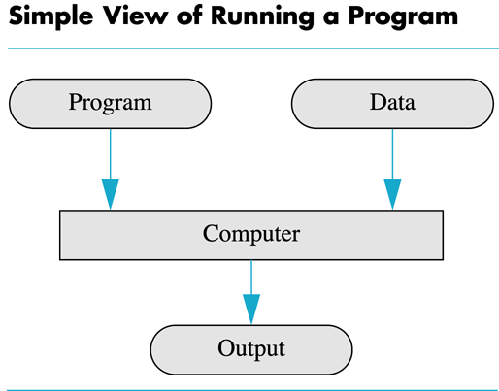

Slide 25
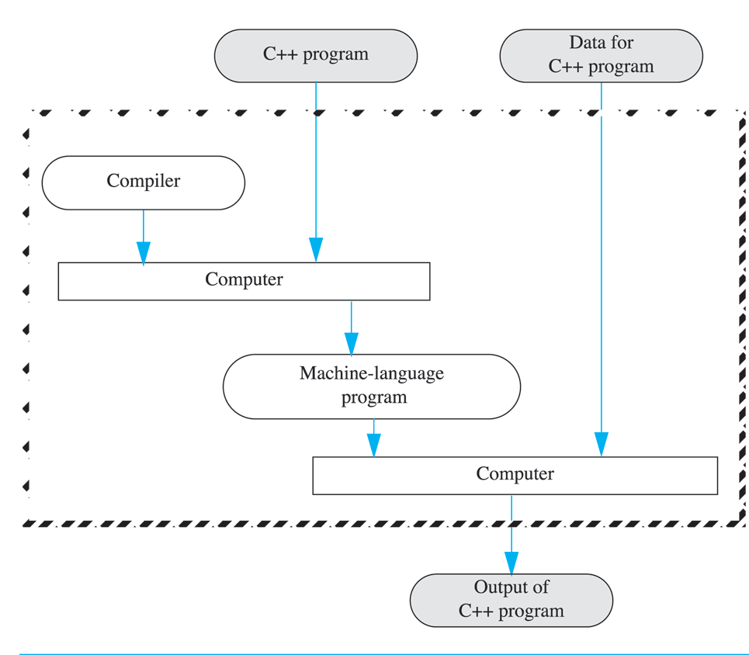
Compiling and Running C++ program

Slide 26
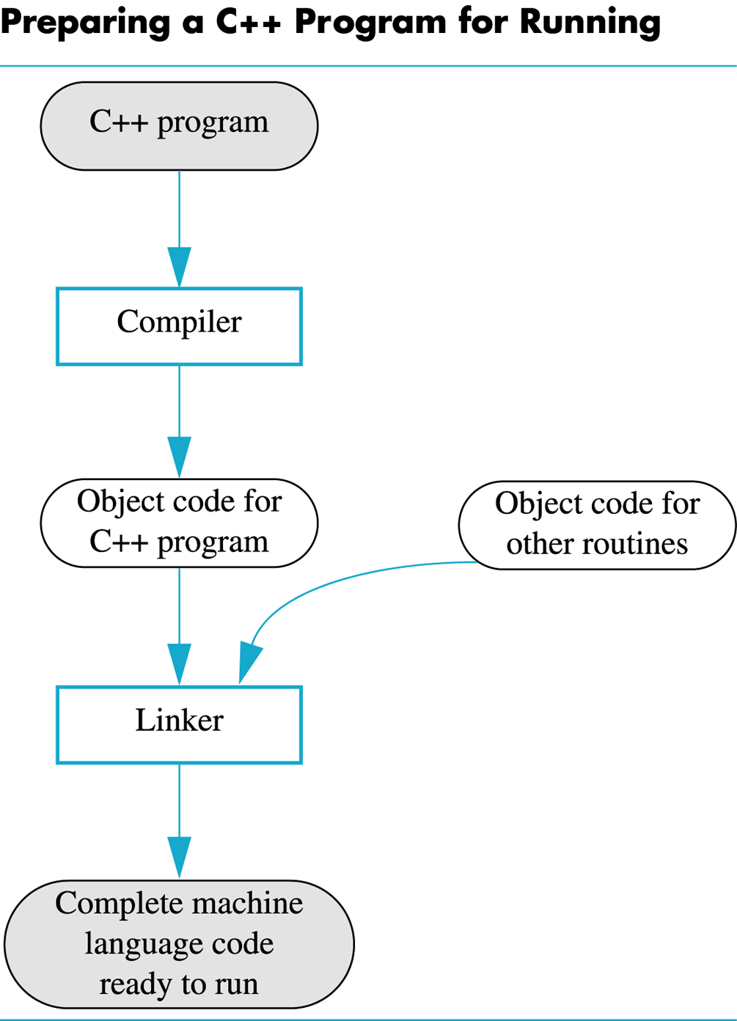
Preparing a C++ Program for Running

Slide 27
Execution process of a C/C++ program
Pre-processing, Compiling, Linking, Loading
Execution of a C/C++ program involves four stages using different compiling/execution tool, these tools are set of programs which help to complete the C/C++ program's execution process.
Preprocessor
Compiler
Linker
Loader

Slide 28
These tools make the program running.
1) Preprocessor
This is the first stage of any C/C++ program execution process; in this stage Preprocessor processes the program before compilation. Preprocessor include header files, expand the Macros.
2) Complier
This is the second stage of any C/C++ program execution process, in this stage generated output file after preprocessing ( with source code) will be passed to the compiler for compilation. Complier will compile the program, checks the errors and generates the object file (this object file contains assembly code).
3) Linker
This is the third stage of any C/C++ program execution process, in this stage Linker links the more than one object files or libraries and generates the executable file.
4) Loader
This is the fourth or final stage of any C/C++ program execution process, in this stage Loader loads the executable file into the main/primary memory. And program run.

Slide 29
Different files during the process of execution
Suppose, you save a C program with prg1.c – here .c is the extension of C code, prg1.c file contains the program (source code of a C program). Preprocessor reads the file and generates the prg1.i (prg1.ii – for c++ source code) file, this file contains the preprocessed code. Compiler reads the prg1.i file and further converts into assembly code and generates prg1.s and then finally generates object code in prg1.o file.
Linker reads prg1.o file and links the other assembly/object code or library files and generates executable file named prg1.exe. Loader loads the prg1.exe file into the main/primary memory and finally program run. One more file is created that contains the source code named prg1.bak; it’s a backup file of the program files.

Slide 30
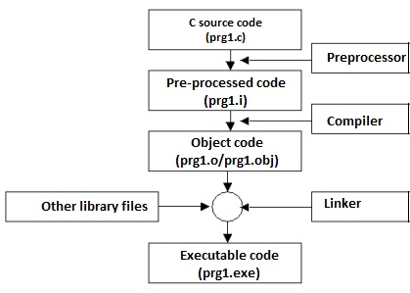

Slide 31
Testing and Debugging
Bug
A mistake in a program
Debugging
Eliminating mistakes in programs
Term used when a moth caused a failed relay on the Harvard Mark 1 computer. Grace Hopper and other programmers taped the moth in logbook stating:
“First actual case of a bug being found.”

Slide 32
Program Errors
Syntax errors
Violation of the grammar rules of the language
Discovered by the compiler
Error messages may not always show correct location of errors
Run-time errors
Error conditions detected by the computer at run-time
Logic errors
Errors in the program’s algorithm
Most difficult to diagnose
Computer does not recognize an error

Slide 33
Section 1-4 Conclusion
Can you…
Describe the three kinds of program errors? Tell what kind of errors the compiler catches? What kind of error is produced if you forget a punctuation symbol such as a semi-colon? Tell what type of error is produced when a program runs but produces incorrect results?

Slide 34
Pitfall and Tips to Programming:
Here are some pitfalls and basic things to be taken care of in any programming language. Some of the tips are specifically with respect to concepts covered in remaining chapters and could be understood well after going through those concepts.
– Plan and be organized: When planning a program it is always better to plan ahead rather than jump straight into it. It is good idea to write down the functions of the program in the order you need to code them, it little ‘blocks’. Even “draw” it if it helps. When actually coding it, use comments. Doing these little things could save your valuable programming time and helps make the code look a little more explanatory and professional.
– Write it out on paper: Think before you code and write the entire idea or the logic of solving a particular problem on paper; doing so would prevent lots of logical errors. This technique also works when you are not able to figure out why the logic is not working .

Slide 35
Indent your program:
Always indent your program for readability. It is a good practice and useful to debug your program. Good indentation makes it easy to see that your closing braces are correctly aligned and help you scan through your code quickly by giving visual clues about where the program flow changes.
Always use comments: Make comments in your code often. Not only does to it help people who are trying to help you understand it more, when you come back later, you’ll be able to pick up where you left off and edit much faster.
For Example:
int age1;/*holds age of first employee*/
Use either // or /* depending on your compiler and language

